Slide 1
Research Topic
Assessment of self esteem and relationship satisfaction in couples counselling
Done By
Marjiya FARVEEN M
II MSC Counselling psychology
Guide
Dr.a.john BALAIAH

Slide 2
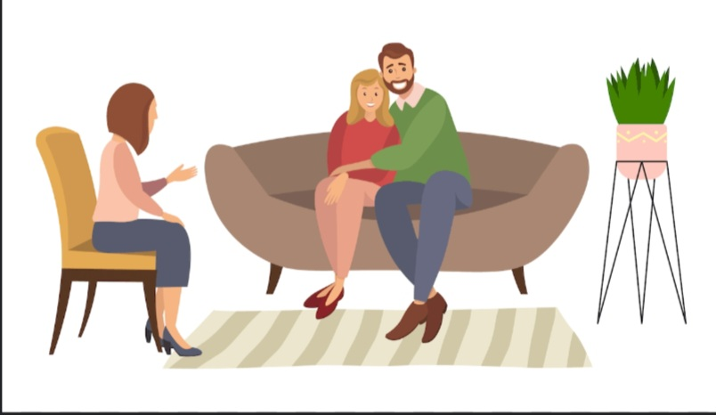
RESEARCH PLAN
CHAPTER 1 – INTRODUCTION
CHAPTER 2 – REVIEW OF LITERATURE
CHAPTER 3 – RESEARCH METHODOLOGY
CHAPTER 4 – ANALYSIS AND FINDINGS
CHAPTER 5 – SUMMARY AND CONCLUSIONS

Slide 3
INTRODUCTION
The first chapter include the introduction about the couples counselling, self esteem, relationship satisfaction and it types ,causes, benefits.
In couples counselling, understanding self-esteem and relationship satisfaction is crucial. Self-esteem affects how people see themselves and act in relationships, while relationship satisfaction reflects overall happiness and connection.
Self-esteem can profoundly influence various aspects of a relationship, including communication, conflict resolution, emotional intimacy, and overall satisfaction.
By understanding how self-esteem impacts the dynamics of a couple’s relationship, we can better support individuals in building healthier self-perceptions and fostering more fulfilling connections with their partners.

Slide 4
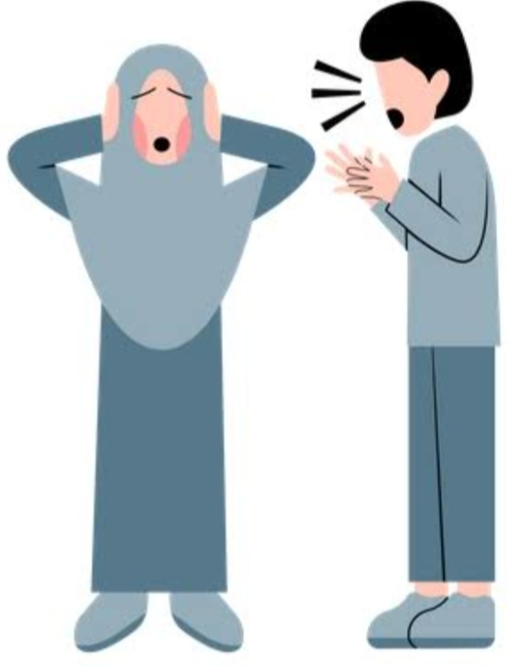
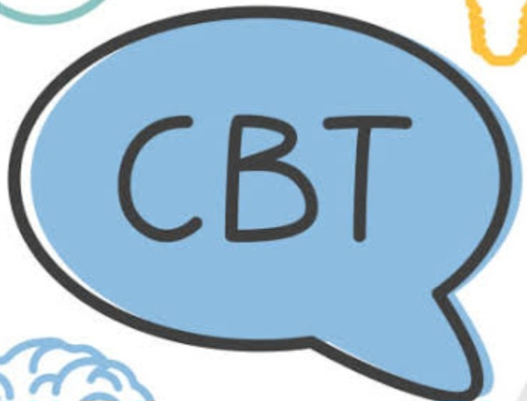
WHY I CHOSE THIS STUDY
I chose this study “ Assessment of self esteem and relationship satisfaction in couples counselling” because
Self-esteem in couples counselling is essential because it directly impacts the dynamics of the relationship.
Through CBT , I aim to assist couples in improving their communication skills, resolving conflicts effectively, and fostering healthier patterns of thinking and behaviour within their relationship.

Slide 5

LITERATURE REVIEW
This chapter include various research study done by numerous researchers with regard to the topic “Assessment of self esteem and relationship satisfaction in couples counselling”.
How other research add value to my research
1) Other studies likely explore similar themes, investigating how different factors such as communication, conflict resolution, and emotional intimacy are influenced by self-esteem levels in couple relationships.
2) They may also discuss the effectiveness of various therapeutic interventions, including CBT, in addressing self-esteem issues and improving relationship satisfaction.
3) By reviewing these articles, I gain insight into potential avenues for exploration or intervention strategies in couples counselling.

Slide 6
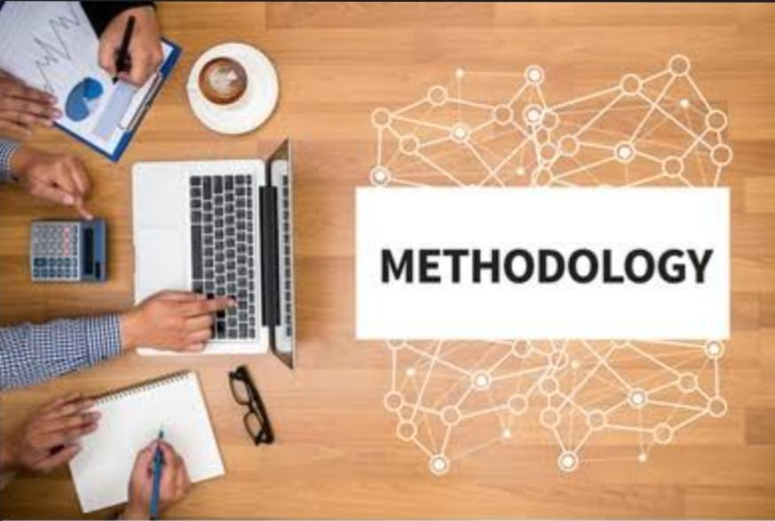
METHODOLOGY AND STATISTICS
Methodology
Survey method
Samples
Married couples (Both male and female)
Age ranging from 20 to 65 years
Sample size : 105
Sampling method: Convenience sampling
Tools used
Rosenberg self esteem scale
Relationship satisfaction scale
Data analysis
“t”test
Anova

Slide 7
STATEMENT OF THE PROBLEM
In this project ,I carry out detailed study on assessment of self esteem and relationship satisfaction in couples counselling
OBJECTIVES
HYPOTHESIS
To explore the level of self esteem among married couples.
To assess the relationship satisfaction among married couples.
To understand the implications of the assessment of self esteem and relationship satisfaction.
To determine the impact of counselling intervention for enhancing self esteem.
There is significant relationship between self esteem and relationship satisfaction
There is a significant relationship between age and both relationship satisfaction and self esteem
CBT is a powerful tool for empowering married couples.

Slide 8
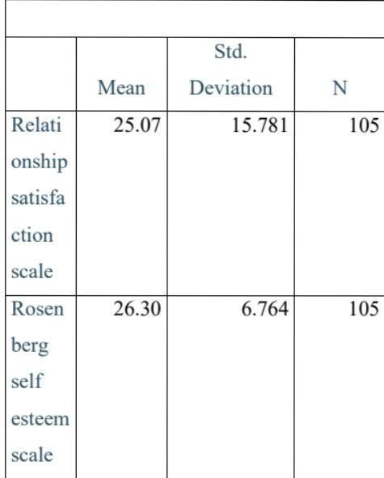
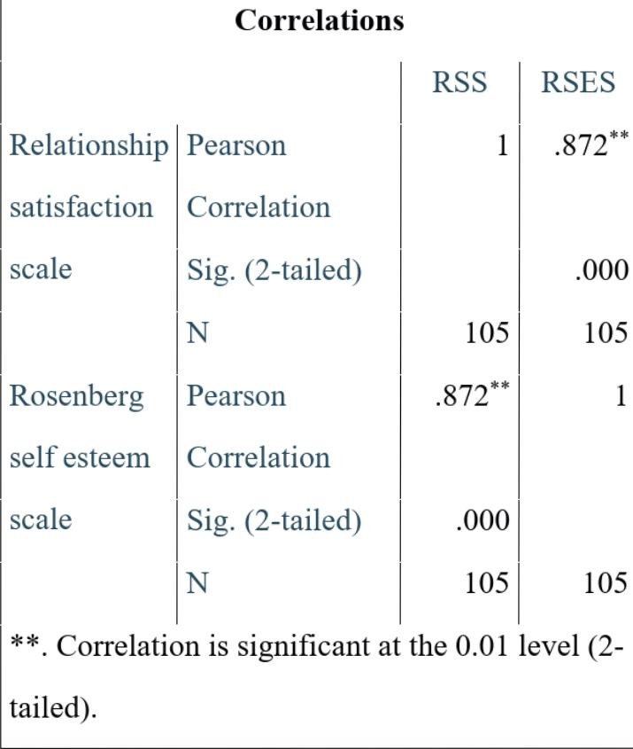
ANALYSIS AND FINDINGS
To investigate the relationship between scores on the relationship satisfaction scale and self esteem scale among population.
There is a significant positive correlation between relationship satisfaction and self esteem.
The finding implies that individuals with high level of self esteem are more likely to report higher level of relationship satisfaction and vice versa.

Slide 9
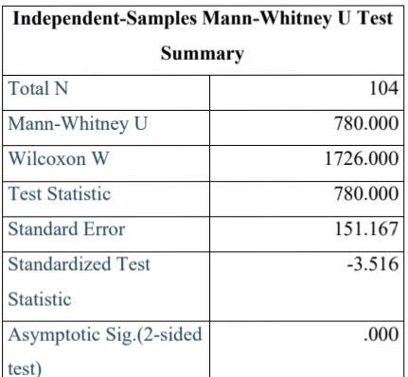
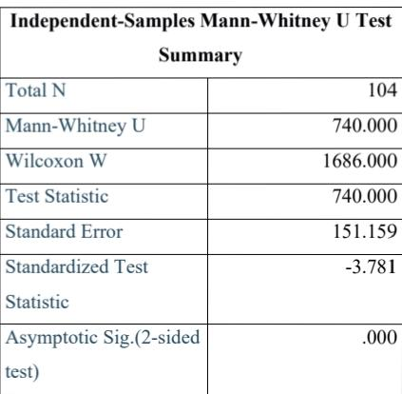
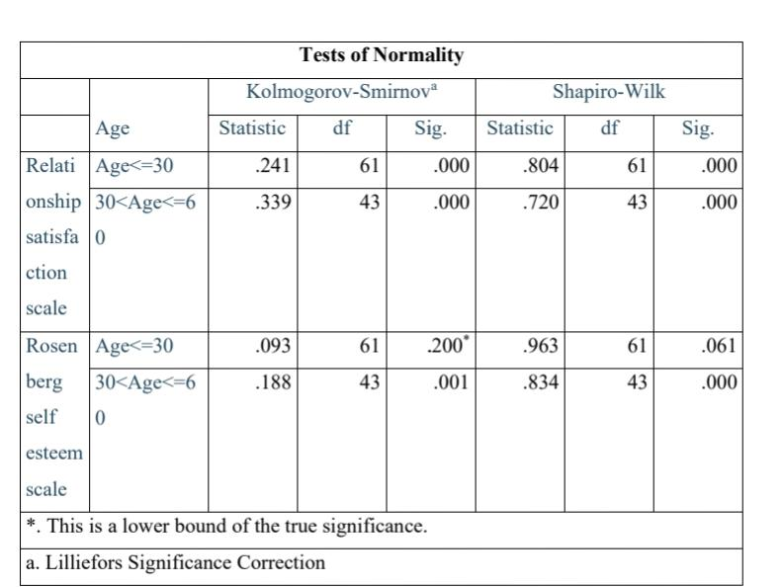
To examine whether there is a significant difference in the distribution of the scores on the age between Rosenberg self esteem scale and Relationship satisfaction scale.
All age group in both relationship satisfaction scale and Rosenberg self esteem scale indicate significant departure from normality except Rosenberg self esteem in the age <=30 the p value is. 061.
Both the independent samples Man Whitney U Test yielded statistically significant result P<.05 for both scales.
The finding implies that age has significant effect on both Relationship satisfaction and self esteem .

Slide 10
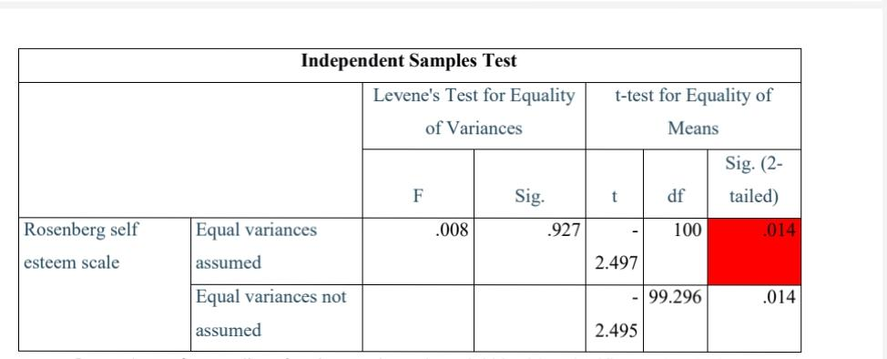
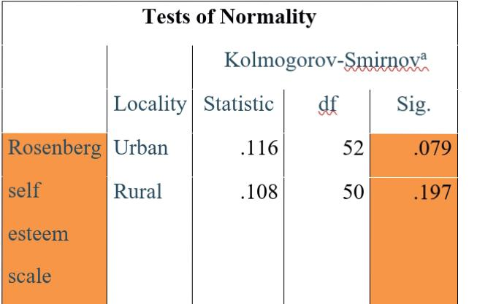
To investigate the difference between locality and self esteem.
There is no significant difference between locality and self esteem.
So we have take parametric test for analyzing the data.
So we have proceed with an independent sample test.
Both t test values yielded a value of 0.014 which is below the significance level of p <.05
The finding implies that there is a significant difference between locality and self esteem .

Slide 11
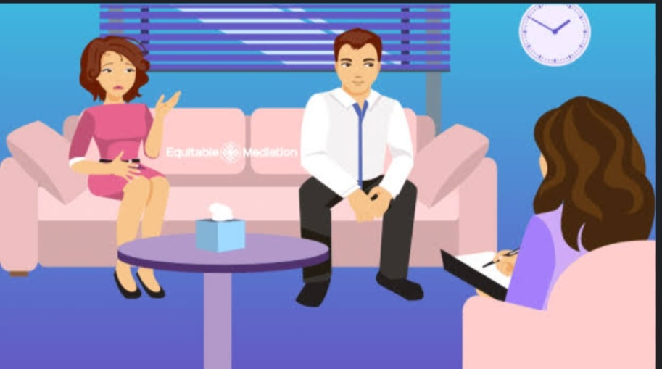
COGNITIVE BEHAVIOUR THERAPY
Cognitive Behavioural Therapy (CBT) has been shown to be highly effective in couples counselling.
CBT helps individuals identify and challenge negative thought patterns and beliefs that may contribute to low self-esteem or dissatisfaction in relationships.
By teaching couples to recognize and modify these harmful thought patterns, CBT can improve communication, problem-solving skills, and overall relationship satisfaction.
Additionally, CBT techniques can help couples develop healthier coping strategies and enhance their ability to manage conflicts constructively, fostering a more fulfilling and resilient relationship.

Slide 12
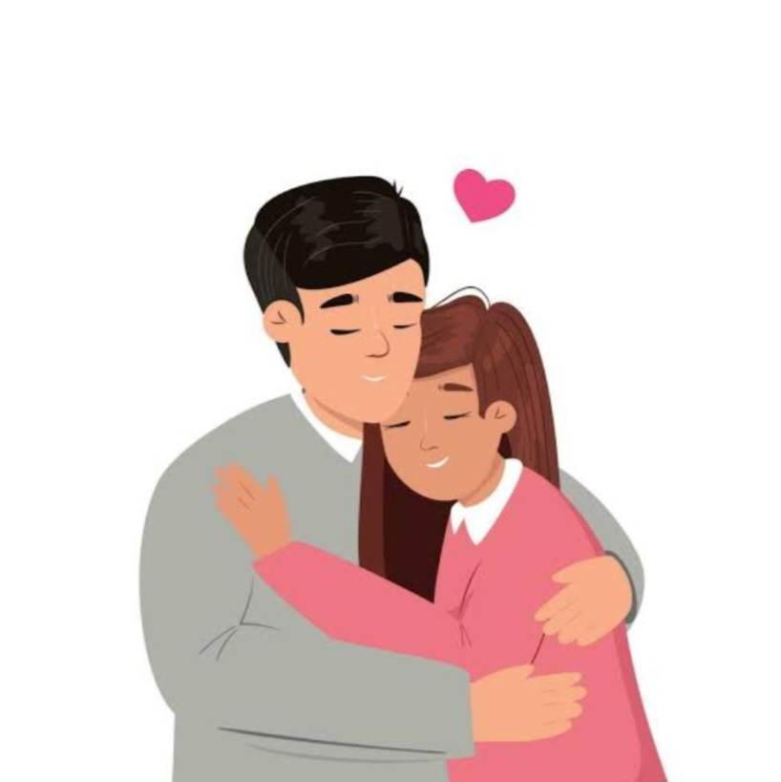
SUMMARY AND CONCLUSIONS
The study explore the relationship between self esteem and relationship satisfaction in couples counselling , focusing on the effectiveness of CBT
There is a significant relationship between relationship satisfaction and self esteem
Demographic details also contribute to the both relationship satisfaction and self esteem
Overall the study highlight the importance of relationship satisfaction and self esteem in couples counselling.

Slide 13
THANK YOU

